Slide 1
An Efficient Approach for Dengue Mitigation A Computational Framework
Nirosha Sumanasinghe Dinayadura
UNIVERSITY OF NORTH TEXAS
December 2018
Armin R. Mikler, Major Professor
Chetan Tiwari, Committee Member
Ranee Bryce, Committee Member
Song Fu, Committee Member
Notes:
My reseach is …

Slide 2

Acknowledgement
Major Professor
Armin R. Mikler
Committee Members
Chetan Tiwari
Ranee Bryce
Song Fu
Notes:
My special thanks go to mikler and

Slide 3
Outline
Contributions
Problem Statement
Literature Review
Methodology
Results
Conclusion
Publications
Notes:
This is how my research is outlined

Slide 4
Contributions
Novel and effective data pre-processing methods
Year-wise data normalization
Novel outlier detection and removal processes
Micro-ensemble for each geographically distinct area
Multiple regressors and best performing ones get into the micro-ensemble
Novel accuracy calculation techniques for regression-based models
Risk-based resource allocation
High risk facilities get fair attention
An effective and efficient modifications to the standard Genetic Algorithm to be used in dengue mitigation
Constrained population generation – eliminate infeasible solutions
Constrained cross overs – preserve facility properties and does not violate basic rules of facilities
Sliding mutation operation – ensures fast convergence

Slide 5
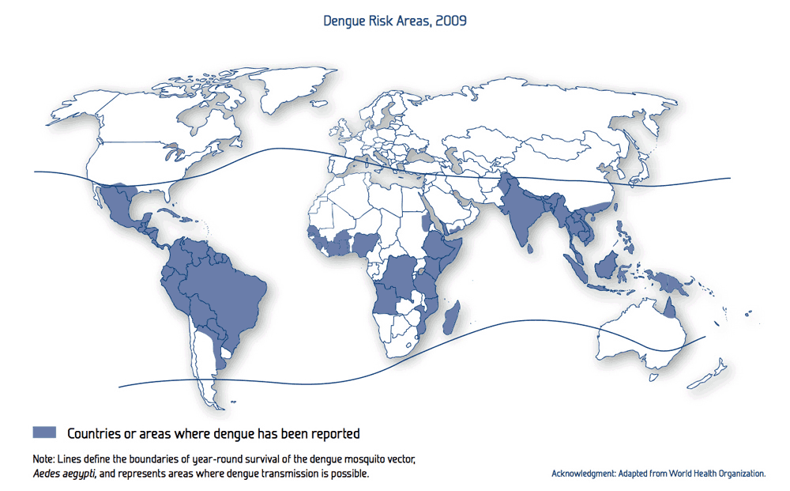
Problem Statement
World Health Organization (WHO) reported that dengue incidence has grown exponentially around the world in last couple of decades
Researchers estimated that 390 million dengue cases per year
Another study conducted estimates that 3900 million people living in 128 countries are at risk
It is prominent in USA neighboring countries
Notes:
Dengue is the fastest…now almost half a world pop is at risk. Previously it was limited to tropical countries

Slide 6
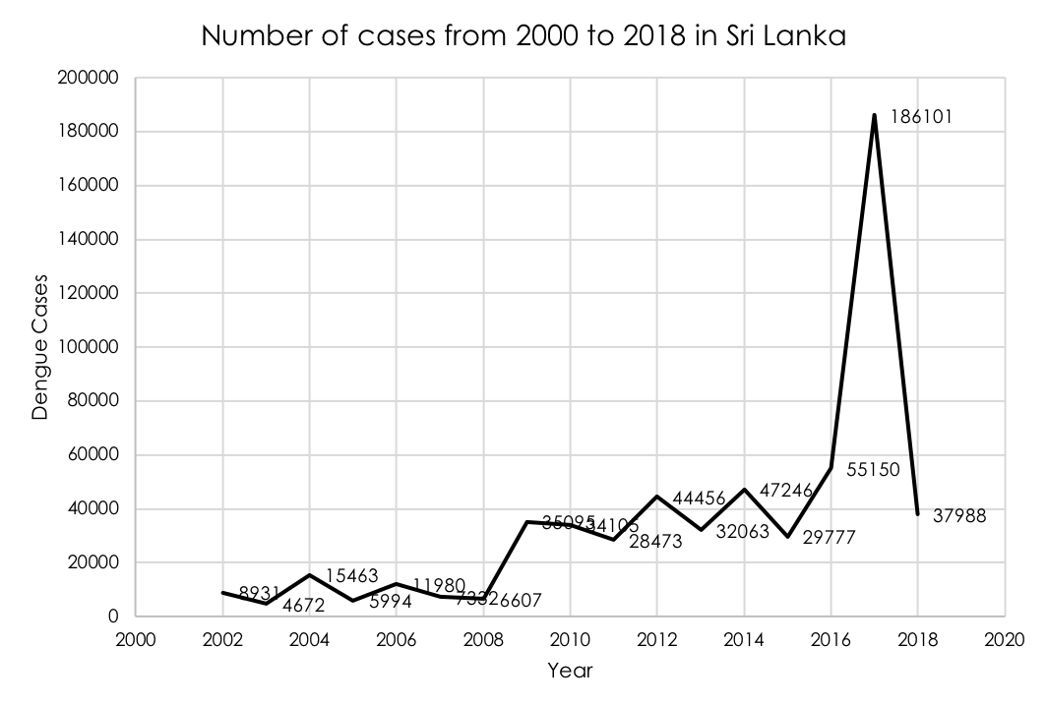
Problem Statement
The status of dengue in south Asian countries is alarming
Sri Lanka reported 37988 dengue cases from Jan to Sept in 2018
In 2017, 158,854 cases reported and 300 deceased due to dengue fever
Notes:
75 percent cases are repored from se asia. Sri lanka has hyper epidemic situation

Slide 7
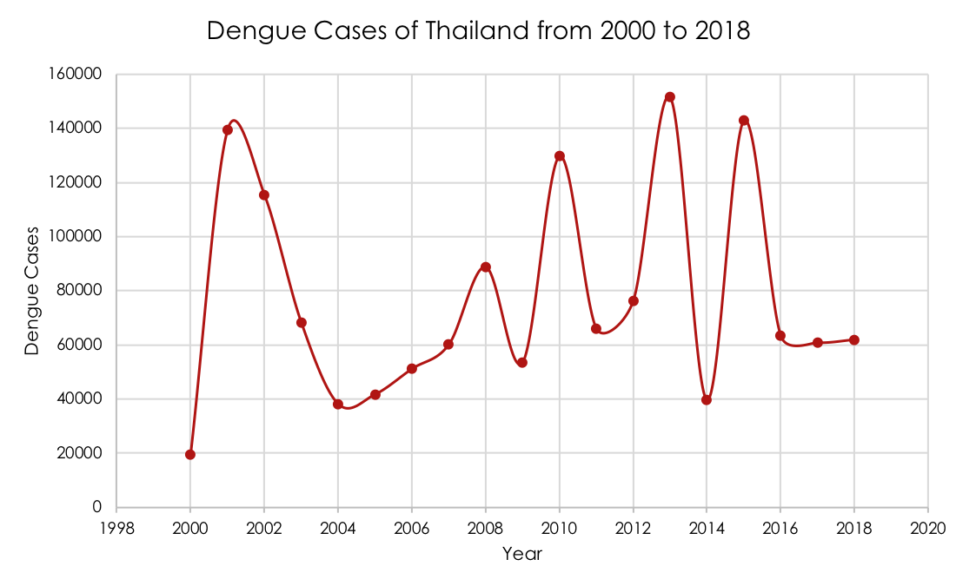
Problem Statement
Thailand reported 6,565 cases from Jan. to April 2018. Nine reported death
Notes:
Thailand has similar conditions like silanka but this is it cases goes

Slide 8

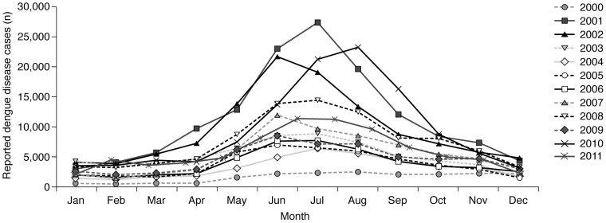
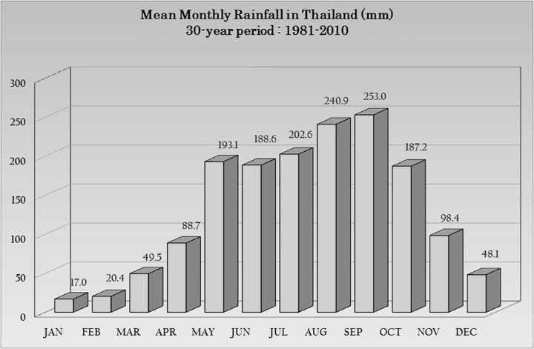
Problem Statement
Dengue Reported Cases
Thailand
Dengue is climate dependent
Rainfall is the major contributing factor beside temperature
High population density greatly contributing for quick propagation of the decease
Average
Rainfall
Month
Notes:
Nothneast and south west monsoon plays a major role. World literature says temp, rain and popdensity placea major role . This figure shows a pattern

Slide 9
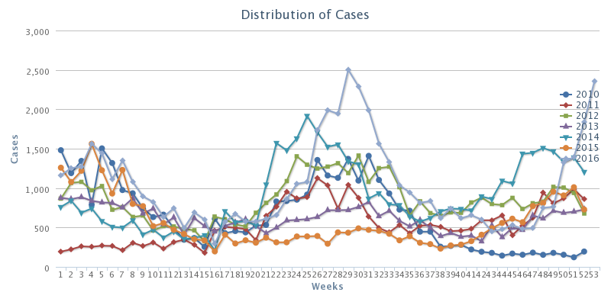
Problem Statement
Distribution of Dengue Cases
Sri Lanka
Climate conditions and dengue cases reported follow the same relation as Thailand

Slide 10
Problem Statement
NEWS Bulletins in Sri Lanka
Dengue mitigation is a big challenge for countries like Sri Lanka and Thailand
Resource scarcity is unavoidable
Proper resource management and allocation is a key factor in successful dengue mitigation

Slide 11
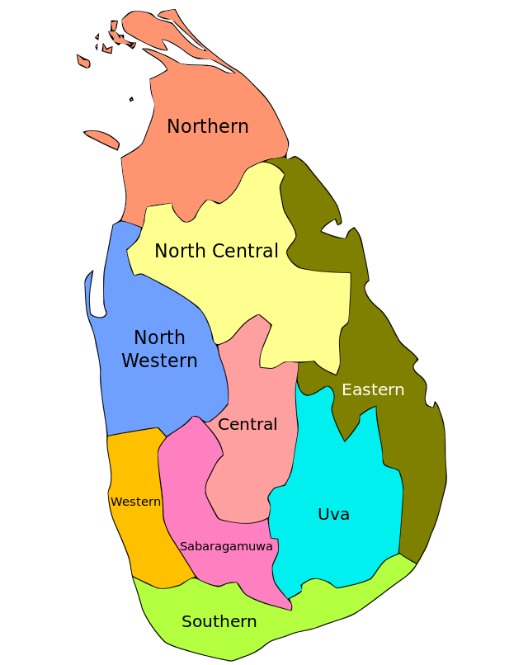
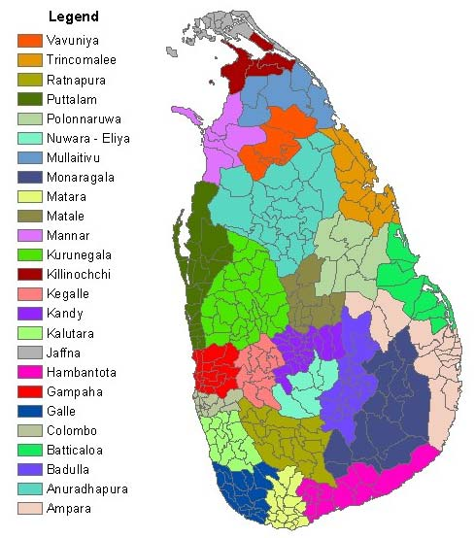
Background
Provinces
Sri Lanka
Located in South Asia
9 provinces
25 districts
Total area is 25,330 sq mi
Population is 20,277,597 (census 2012)
The main sources of rainfall are Monsoonal, Convectional and expressional rain
Districts

Slide 12
Background Cont’d
Thailand
Located in Southeast Asia
76 provinces
Total area is 198,120 sq mi
population is 64,785,909 (Census 2010)
Three climate seasons
Southwest monsoon season
Northeast monsoon season
Pre-monsoon

Slide 13
Literature Review
Dengue Epidemic
Dengue Virus
Surveys of Dengue
WHO reports
Epidemic Prediction
GIS and Statistical Models
Neural Network
Cellular Automata
SVM
Resource Allocation
Climate and Dengue relation
Statistical
Agent-based
Dynamic Modeling

Slide 14
Methodology
1. Rainfall, Temperature, Dengue Incidence, Population Data
2. Data Alignment and Cropping
Data Acquisition
Data Pre-Analysis
Correlation Analysis
GWR Analysis
1. Year-wise Data Normalization,
2. Outlier Removal with Iterative Convex Hull Method
Data Pre-Processing
1. SVR
2. Least Square Regression
3. K-NN
4. Ensemble (With Best Models)
Model Generation
1. 10-Fold Cross Validation (Prediction)
2. Proposed Accuracy Calculator
Model Validation
Proposed Genetic Algorithm
Resource Allocation
Notes:
I used remote sensing data for rainfall lot of processing were needed. Then correlation analysis of dependent and independent vb were used to see the relationship between vbs. Befor applying a prediction model pattern of data were iodentified from yearwise normalization several regression models were employed and micro ensemble architecture were used for prediction. For model evaluation k fold cross used and a novel method of accuracy calculation was used. For resource allocation genetc alogo rithem with new improvement was used

Slide 15
Methodology Cont’d
Data Acquisition
Rainfall Data
Global Rainfall Map in Near Real Time from JAXA Global Rainfall Watch
Temperature Data
Thailand Meteorological Dept. (TMD) and NASA Earth Observations (NEO)
Population Data
Department of Census of Thailand and Sri Lanka
Dengue Cases
Epidemiology Unit of Sri Lanka and Thailand

Slide 16
Data Acquisition - Data Statistics
Thailand
76 Provinces
Sri Lanka
25 Districts
Provinces of Thailand
Districts of Sri Lanka

Slide 17
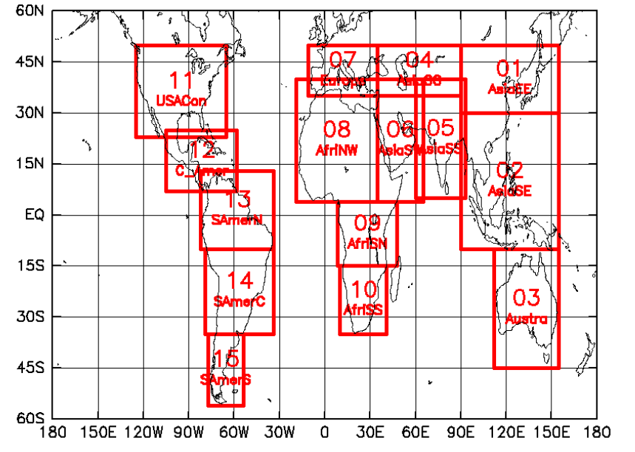
Data Acquisition - Rainfall
Area name | Lon(W) | Lon(E) | Lat(S) | Lat(N) | Description
01_AsiaEE | 90 | 155 | 30 | 50 | East Asia
02_AsiaSE | 90 | 155 | -10 | 30 | South East Asia
04_AsiaCC | 35 | 90 | 35 | 50 | Central Asia
05_AsiaSS | 60 | 93 | 5 | 40 | South Asia
06_AsiaSW | 35 | 65 | 4 | 40 | Arabian Peninsula and East Africa
Region Description of JAXA data set
Regions of JAXA data acquisition : Source - JAXA Web Portal

Slide 18
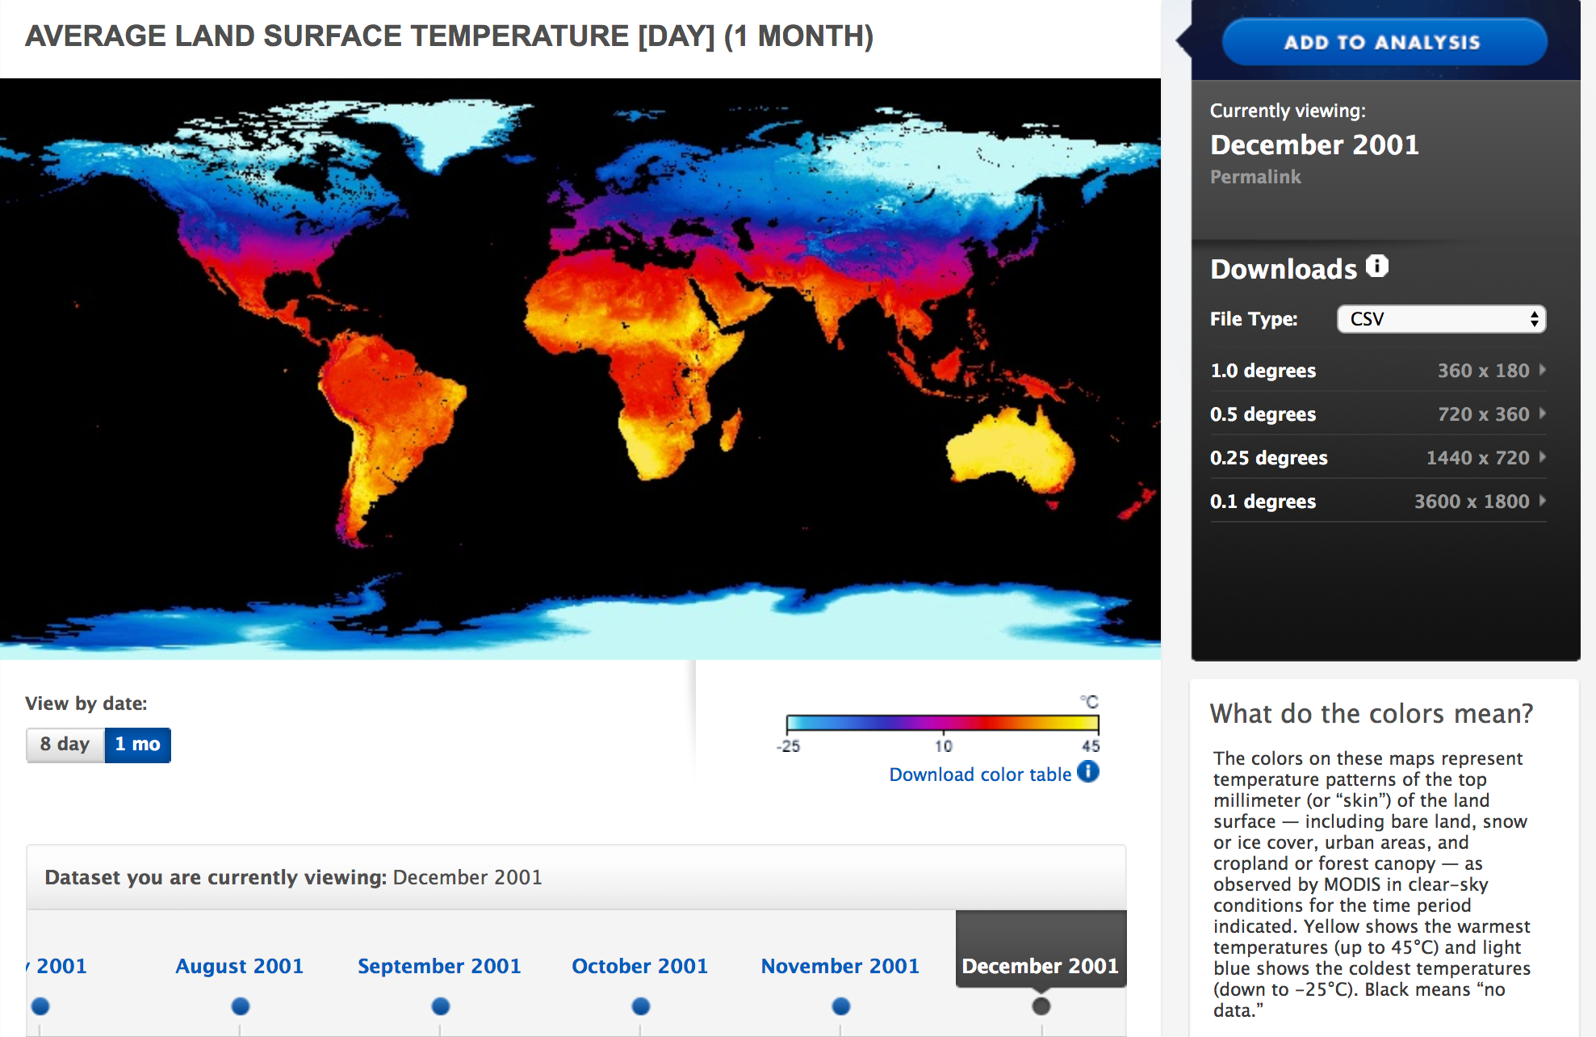
Data Acquisition - Temperature
Thailand – From TMD, NEO, GSMAP NRT
Sri Lanka – From NEO GSMap-NRT
NEO Data Portal – https://neo.sci.gsfc.nasa.gov/
Notes:
Remote sensing Temperature and rainfall data was used. For temperature nasa neo data was used. Csv files with 0.1 resolution was used it has long lati and temperaturr to that point. We get temp for whole world. Data set were cropped using longi and lati

Slide 19
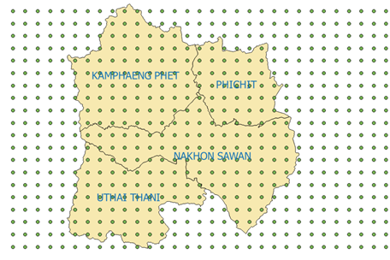
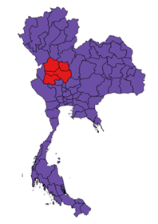
Data Acquisition - Cropping
Data File
Data Points

Slide 20
Methodology Cont’d
Data Pre-analysis
Regression-based predictors
Support Vector Regression, Least Square Regression, and KNN-regression
Need a strong correlation between dependent variable and independent variables
Ex: Dengue Incidence and rainfall
Conducted a correlation analysis on each independent variable
Dengue incidence is geographically varying
Need to conduct GWR to determine the status of the dengue epidemic

Slide 21
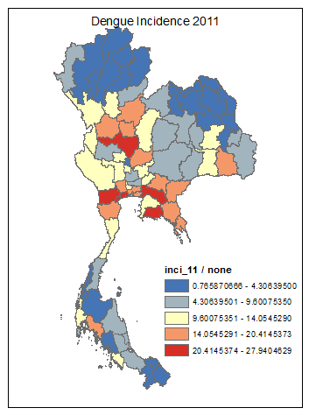
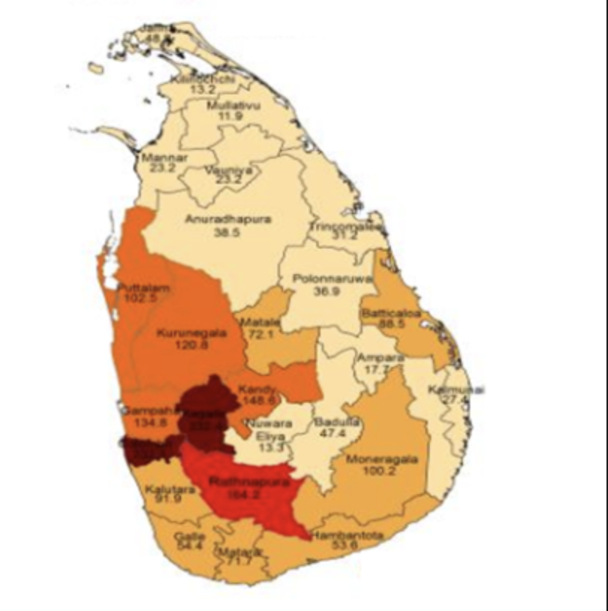
Data Pre-analysis - GWR
GWR detects spatial heterogeneity of dengue epidemic
Each district responds to influencing factors of the dengue epidemic differently
We need to determine the status of the dengue epidemic using GWR
If spatially dependent: Need local models for each district
If not spatially dependent: Global model for entire country is sufficient
Incidence map of Dengue in Thailand 2011
Incidence map of Dengue in Sri Lanka 2014

Slide 22
Methodology Cont’d
Data Pre-processing
Existence of noise in the data set is highly likely
There may be unknown shifts in each year (Rapid increases)
A controlled noise removal procedure is necessary
I proposed to eliminate year specific effects with year-wise data normalization
I propose an iterative procedure that uses convex hulls to remove noise points

Slide 23
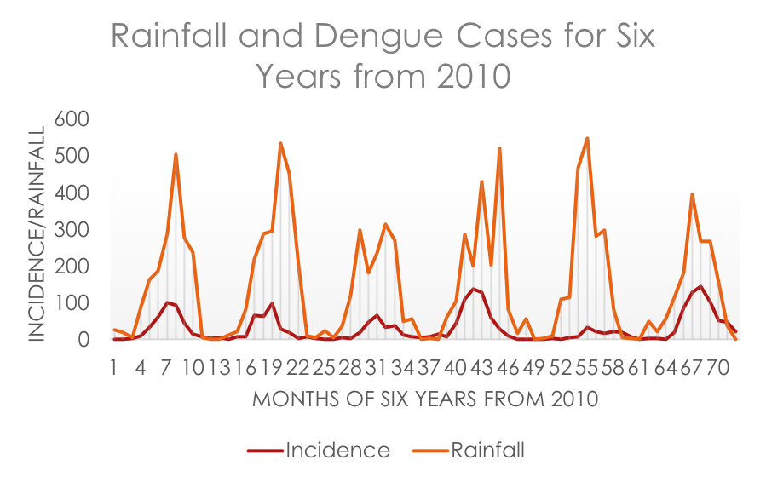
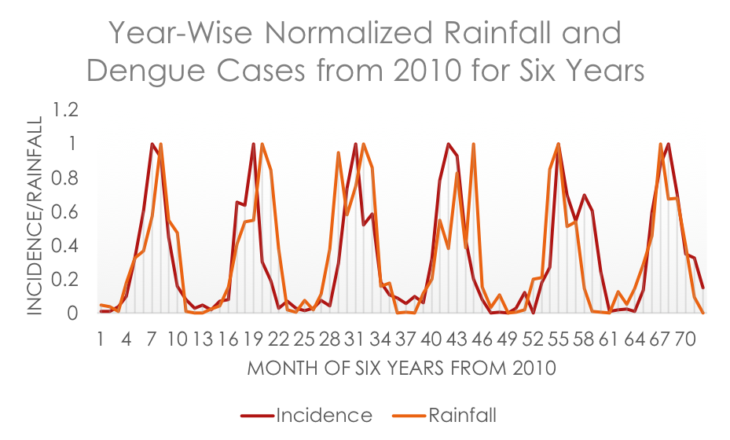
Data Pre-processing – Year wise Data Normalization
Data normalization for 76 provinces of Thailand
Captures the pattern that aligns with rainfall – no spikes
Sudden Spikes

Slide 24
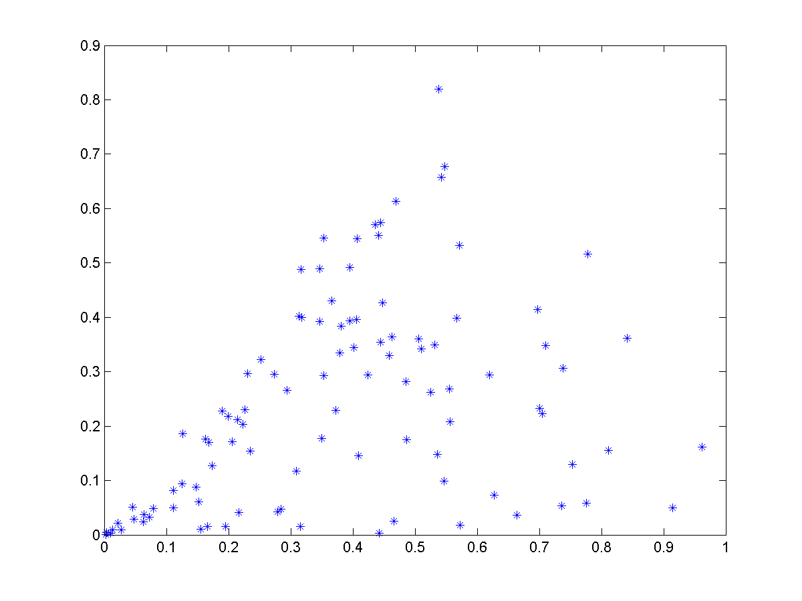
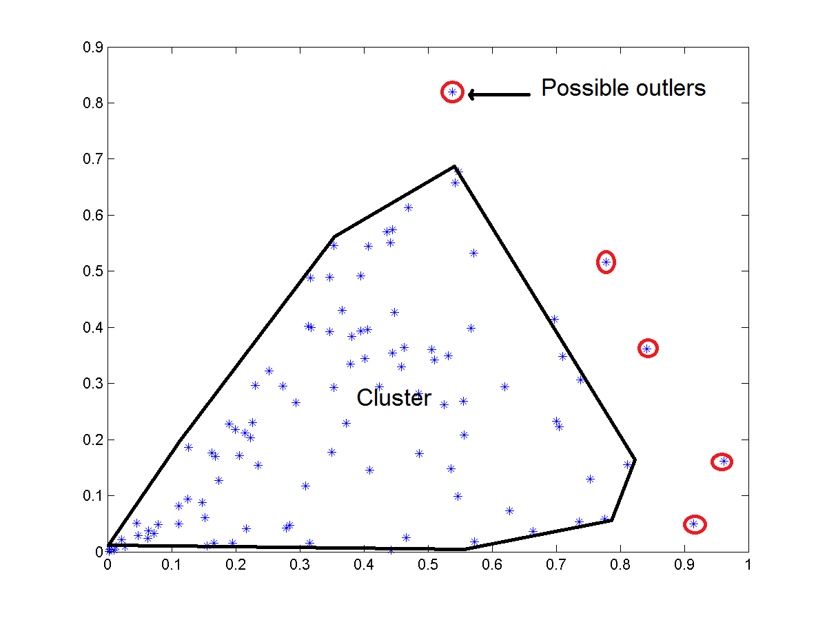
Data Pre-processing – Noise Removal
Rainfall
Dengue Incidence
Rainfall
Dengue Incidence
Notes:
Since correlation is law

Slide 25
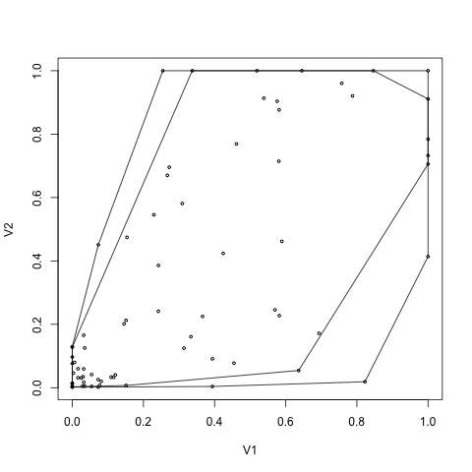
Outlier Removal Levels
Outliers are removed in multiple stages
Optimum number of levels is problem dependent
Experimentally determined
Two levels of outlier removals were used in this study
Figure shows outlier removal for the province Buen Kan of Thailand
Two levels of outlier convex hulls -
V1-Rainfall, V2-Dengue Incidence

Slide 26
Outlier Removal
Determining whether an outlier is present
Steps
Compute outer convex hull
Remove points that forms outer convex hull from the dataset and recompute convex hull
Compute the surface area of both convex hulls
Get the difference in area
Presence of an outlier is confirmed If the difference in area as a percentage exceeds the predefined threshold
$$∆A=|{A\left(ConvexHull\right)}_{i}− {A\left(ConvexHull\right)}_{i−1}|$$

Slide 27
Outlier Removal
Identifying the Correct Outlier Point (s)
Steps
Precondition: An outlier is present in the dataset
Compute the difference in area using leave-one-out method
Sort the computed areas in descending order
Points that give the maximum difference in area when removing from the hull labelled as outliers
More than one points can be removed with a use of a threshold value

Slide 28
Methodology Cont’d
Model Generation
Three models are trained for a each district
Support Vector Regression (SVR)
Least Square Regression (LS)
K-Nearest Neighbor Regression
One ensemble model for each district is generated
Select the best performing models for each district and build micro ensemble
Notes:
Because of spacial

Slide 29
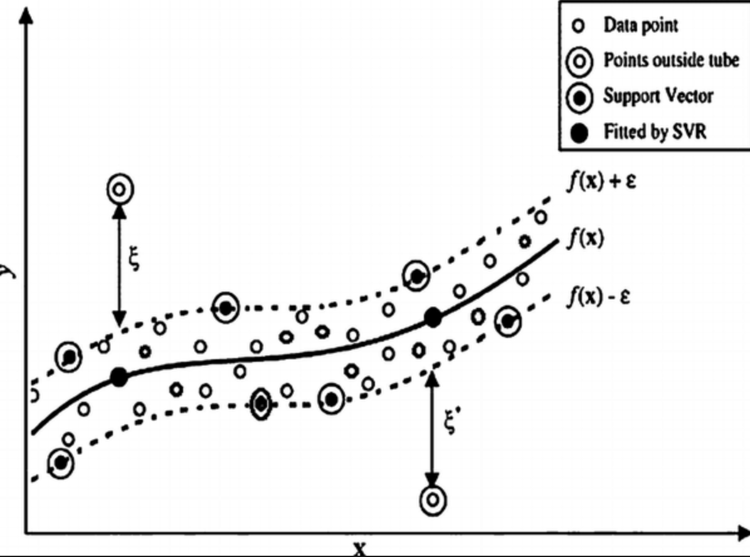
Model generation - SVR
The SVR model is based on the regression analysis
A regression analysis can estimate the relationship between two data sets (random variable) and fit a cure to the data sets (explanatory variable and dependent variable).
Pi – Population, Ri-Rainfall, Ti-Temperature
$$C_{di}= β_{0}+ β_{1}P_{i}+ β_{2}R_{i}+ β_{3}T_{i}$$

Slide 30
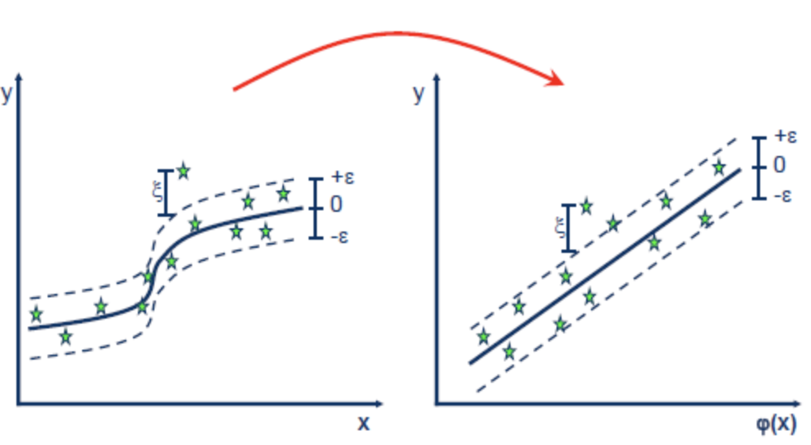

Model generation - SVR
SVM regression is constructed by first mapping the input vector X into an m-dimensional feature space
Non-linear mapping function
The linear regression model is then constructed in this feature space.
Feature space transformation (Non-linear to linear)
$K\left(x_{i},x\right)=\sum_{j=1}^{m}{∅_{j}(x)∅_{j}(x_{i})}$

Slide 31
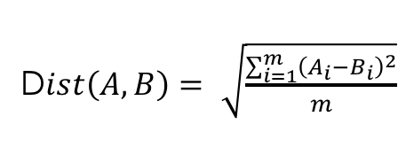
Model generation – KNN Regression
Distance Metric is Euclidean Distance
D$ist\left(A, B\right)= \sqrt{\frac{\sum_{i=1}^{m}{{\left(A_{i}−B_{i}\right)}^{2}}}{m}}$
KNN regression is to calculate the average of the numerical target of the K nearest neighbors.
KNN regression uses the same distance functions as KNN classification.

Slide 32
Model generation - LS
Y
Each explanatory variable in the function is multiplied by an unknown parameter,
There is at most one unknown parameter with no corresponding explanatory variable, and
All of the individual terms are summed to produce the final function value.
There is no ribbon as in SVR – Considers all the point in estimation process
X
$$C_{di}= β_{0}+ β_{1}P_{i}+ β_{2}R_{i}+ β_{3}T_{i}$$

Slide 33
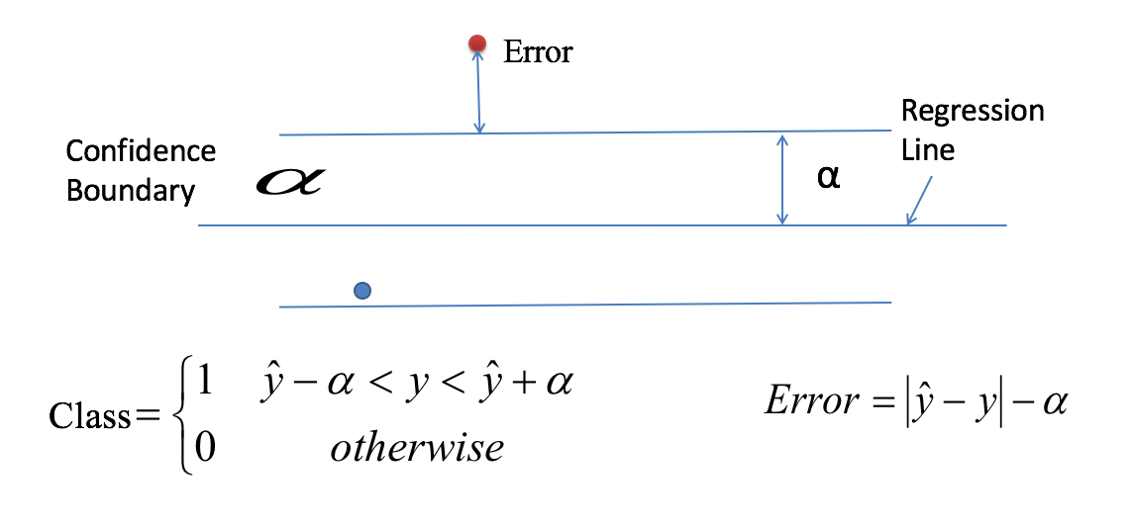
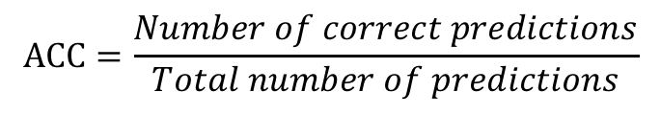
Methodology Cont’d
Model validation
Performance of the regressor needs to be calculated
Regular regressor are evaluated with MSE
MSE is bias towards extreme outliers
Need a mechanism of eliminating outliers in model validation
Introduced a novel accuracy calculation method
With a confidence boundary alpha
$$ACC=\frac{Number of correct predictions}{Total number of predictions}$$

Slide 34
Model validation
Cross-validation is a model validation technique for assessing how the results of an analysis will generalize to the underlying population of the extracted data set
10-fole cross validation with the proposed accuracy calculator was used
Dataset is divided into 10 partitions
Leave-one-out raining is performed
The left out partition is used to test the trained model
This process repeats 10 times
Dataset is divided randomly

Slide 35
Methodology Cont’d
Resource allocation
A successful mitigation plan includes an effective resource allocation scheme
An effective resource allocation should eliminate wastage, over allocation and under allocation of resources while satisfying the demand of each facility
I propose to use Genetic Algorithm for resource allocation with subtle changes to the base algorithm.
These changes ensure that GA produces best results in less time
GA allows us to model the problem domain requirements as needed

Slide 36

Methodology Cont’d
Bi-partite representation of the problem
F1
W₀₂
Rm
Problem Definition
Let F₁,F₂….F_{n} is the set of facilities demanding for resources R₁, R₂,……R_{m} with a demand for each resource W₀₀, W₀₁,…….W_{nm}
$W_{ij}∈ ℝ [0,m]$
The final allocated scheme is represented as A₀₀, A₀₁,…..A_{nm}
The problem can be represented with a bi-partite graph
W_{ij}
Fn
Rm

Slide 37
Genetic Algorithm
Search based optimization algorithm inspired by natural selection and evolution
Fully random population generation
Select candidates for next generation based on a fitness value
Terminate when the maximum iteration reached or the best fit solution found

Slide 38
Genetic Algorithm – Changes Introduced
Algorithm 2: Proposed GA
1: k ← 0; 2: PK ← InitPopulation(n, resourcesMap) {Generating Initial Population with n individuals and constraints} 3: Compute fitness(I, facilityInfo) for each i ∈ Pk; {Evaluate everyone in the population Pk: } 4: While not termination do 5: sort(Pk) {sorting the population in descending order} 6: Select (1 − ChurnEntropy) × n members of Pk and insert into Pk+1; { Select Subset of PK:} 7: Select ChurnEntropy × n members of Pk; generate crossover with constraints; insert the offspring into Pk+1; { Crossover:} 8: Select MutationEntropy × n members of Pk+1; perform constrained and sliding mutation based on risk; {Mutate} applyRiskBasedPenalty for each individual; {applying over and under allocation penalty} 9: Compute fitness(I, facilityInfo) for each i ∈ Pk; { Evaluate Pk+1:} 10: k ← k + 1; 11: end while 12: return the fittest individual from Pk;
Algorithm 1: Standard GA
1: k ← 0; 2: PK ← InitPopulation(n) {Generating Initial Population with n individuals} 3: Compute fitness(i) for each i ∈ Pk; {Evaluate everyone in the population Pk: } 4: While not termination do 5: sort(Pk) {sorting the population in descending order} 6: Select (1 − ChurnEntropy) × n members of Pk and insert into Pk+1; { Select Subset of PK:} 7: Select ChurnEntropy × n members of Pk; pair them up; produce offspring; insert the offspring into Pk+1; { Crossover:} 8: Select MutationEntropy × n members of Pk+1; invert a randomly-selected bit in each; {Mutate} 9: Compute fitness(i) for each i ∈ Pk; { Evaluate Pk+1:} 10: k ← k + 1; 11: end while 12: return the fittest individual from Pk;

Slide 39
Proposed Genetic Algorithm Changes
Introducing chromosome representation for resource allocation
Change the way the standard GA generates the initial population.
Chane the way the standard GA does crossover operation
Change the way the standard GA does mutation
Introduction of resource lock chromosome
Introducing sliding mutation scheme to accelerate the convergence
Change the iteration of the GA to accommodate sliding mutation scheme

Slide 40
Representation of the Problem
Standard GA uses bits as genes and sequence of genes as a chromosome
Proposed GA uses weights as genes
Facility boundaries must be preserved

Slide 41

Proposed Population Generation Procedure
A constraint is set forth and eliminates chromosomes that violate the constraint
$$Allocated Amount of Resource\left(i\right)=\sum_{j=1}^{n}{A_{ji}} :1≤i≤m$$
Constraint -> $Allocated Amount of Resource \left(i\right)$ $≤$ Available amount of resources (i)

Slide 42
Proposed Crossover Operation
Must preserve facility boundaries

Slide 43
Proposed Mutation Operation
Mutation must not violate resource availability constraint
Randomly pick two facilities and do mutual mutation
Over allocation is regularized by the OverAllocationPenaly parameter introduced

Slide 44

Fitness function
The fitness function is modeled as a function of risk associated with the given facility based on population count of the facility, amount of area to be served by the facility.
Fitness = 1/ Final risk value
$$Final risk value$$
$$= \sum_{i=0}^{n}{\sum_{j=0}^{m}{{|R_{j}\left(allocated\right)− R_{j}\left(Demanded\right)| }_{i}∗Area∗Risk∗population}}$$

Slide 45
Proposed Concept of Locked Genes
Abundant resources should not overload the GA
Only limited resources should be considered
Introduce a concept of lock chromosome where abundant resources are locked

Slide 46
Proposed Sliding Mutation Scheme
The amount of mutation should be proportional to the risk associated with the current allocation
Random mutation fluctuate fitness up and down
Sliding mutation adjust the amount of mutation based on the current risk of the chromosome
This concept closely resemble gradient decent algorithm

Slide 47


Proposed Sliding Mutation Scheme
Amount of mutation is determined by the following steps
Compute the distance between allocated chromosome and the target chromosome
Compute the percentage of the distance calculated
Get the remaining percentage to reach the target
Compute the amount of mutation as a percentage of the already allocated amount
D$istance(Allocated)= \sum_{i=1}^{n}{|Target\left(i\right)−Allocated\left(i\right)| }$
$Remaining Percentage=\frac{\sum_{i=1}^{n}{Target\left(i\right)} −Distance(Allocated)}{\sum_{i=1}^{n}{Target\left(i\right)}}$ $∗100$
$$Amount of Mutaton\left(i\right)=random\left(0,\left(Allocated\left(i\right)∗Remainig Percentage\right)\right) for i=1…n$$

Slide 48
Results
Pre-analysis results
Correlation analysis
GWR analysis
Pre-processing results
Year-wise data normalization
Outlier removal
Prediction results
Global model
Local models (ensemble)
Resource allocation results

Slide 49
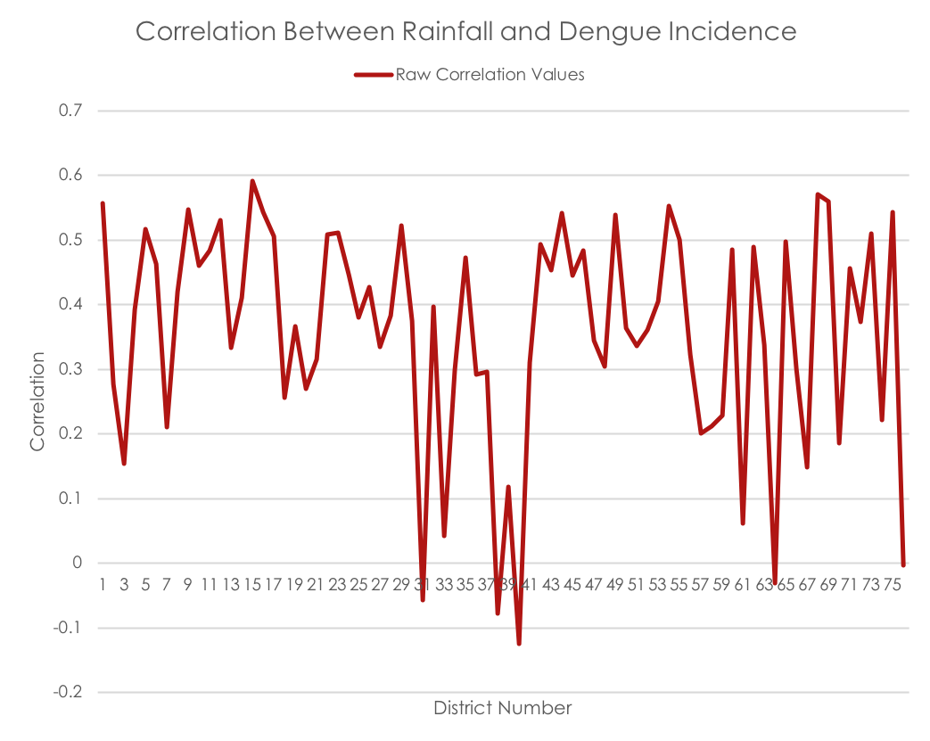
Pre-analysis Results - Thailand
Correlation analysis
Correlation between rainfall and dengue incidence
76 Provinces of Thailand
Observe that most of the correlation values fall under 0.5

Slide 50
Pre-analysis Results – Sri Lanka
GWR analysis
Each district has different coefficient for GWR analysis
The rate of change in dengue incidence is different from district to district
A separate model for each district is necessary to closely model the behaviour
(a)
(b)
The spatial distribution of regression coefficients for (a) population density (b) rainfall.
Notes:
Mannar for example, low rainfall but high dengue incidence.
Nuwara Eliya: high rainfall but low dengue incidence

Slide 51
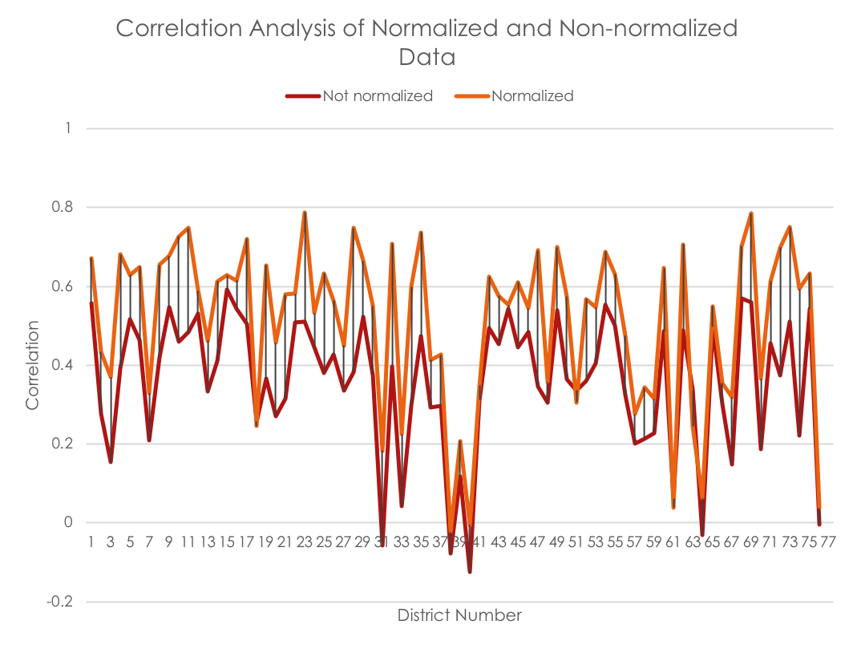
Pre-processing Results - Thailand
Year-wise data normalization
Rainfall patter is same for all six years
Dengue incidence is different for each year
Other factors causes the fluctuation
Need to eliminate year specific events such as flooding, droughts, etc.
Year-wise data normalization is proposed
Better results from regressions with normalized data
Correlation comparison with and without Normalization
Notes:
Please note the increase in correlation after data normalization

Slide 52
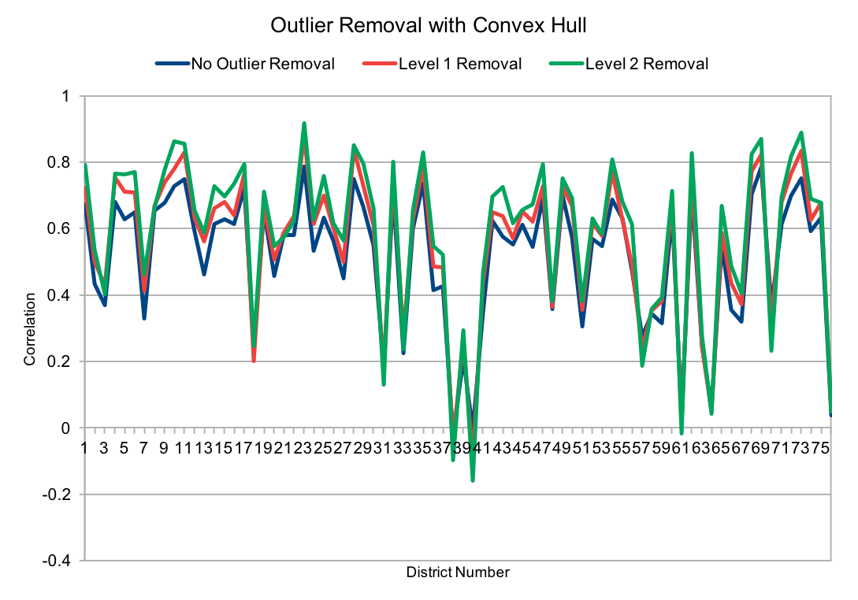
Pre-processing Results - Thailand
Outlier removal
Presence of outliers causes SVR to underperform
Outliers causes to have very low correlation coefficients
Removal of outliers causes correlation to back up
Higher correlation between factors causes SVR to perform better
Multiple level of outlier removals gradually increase the correlation at each step
Correlation for all Provinces at each Outlier Removal Level

Slide 53
Prediction Results
A global model from each regressor was trained as a reference
SVR, LS, KNN
Local models and micro-ensemble for each district generated
SVR, LS, KNN
Micro-ensemble with the best performing regressors

Slide 54
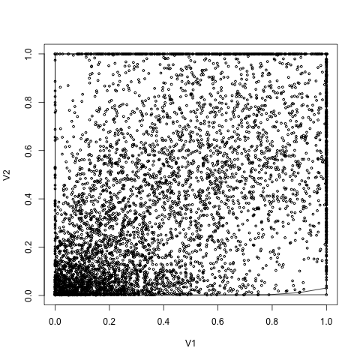
Prediction Results - Thailand
Global model
SVR was trained on the entire dataset comprising of data point from all 76 provinces
Multiple level of outlier removals applied
The Plot of Rainfall vs Dengue Incidence for the Global Dataset (v1-rainfall, v2-dengue incidence)
Notes:
This is the actual data projection

Slide 55
Prediction Results - Thailand
Correlation Coefficient for Three Levels of Outlier Removals on Global Dataset
Level of outlier removal | Correlation Coefficient
Level 0 | 0.523
Level 1 | 0.524
Level 2 | 0.525
Multiple level of outlier removals did not contribute for significant increase in correlation
The amount of increase is given in the table on the right

Slide 56
Prediction Results - Thailand
Results of 10-fold Cross Validation of SVR on Global Dataset
Fold | Accuracy | MSE
1 | 63.25 | 0.19322216
2 | 56.85 | 0.20835374
3 | 59.23 | 0.20811646
4 | 55.94 | 0.21453015
5 | 63.07 | 0.19367864
6 | 59.41 | 0.20107433
7 | 58.68 | 0.20458908
8 | 60.51 | 0.2005876
9 | 60.14 | 0.20600364
10 | 59.04 | 0.20545753
Average | 59.61 | 0.20356133
10-fold cross validation was performed on the global data set
Results are given in the table on the right

Slide 57
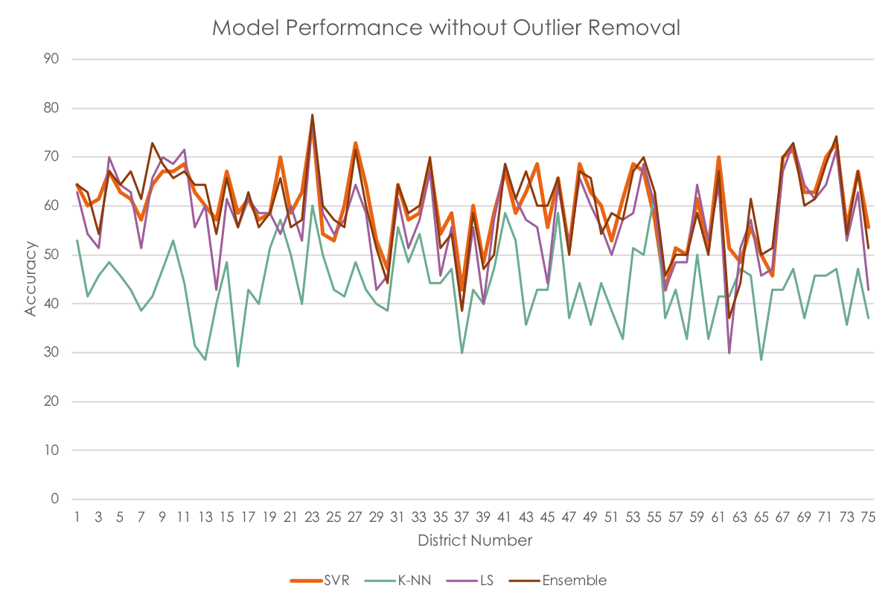
Prediction Results - Thailand
Prediction results without outlier removal
Predictions results for all 76 provinces using local models
SVR, LS, KNN and micro-ensemble
The model performance without outlier removal

Slide 58
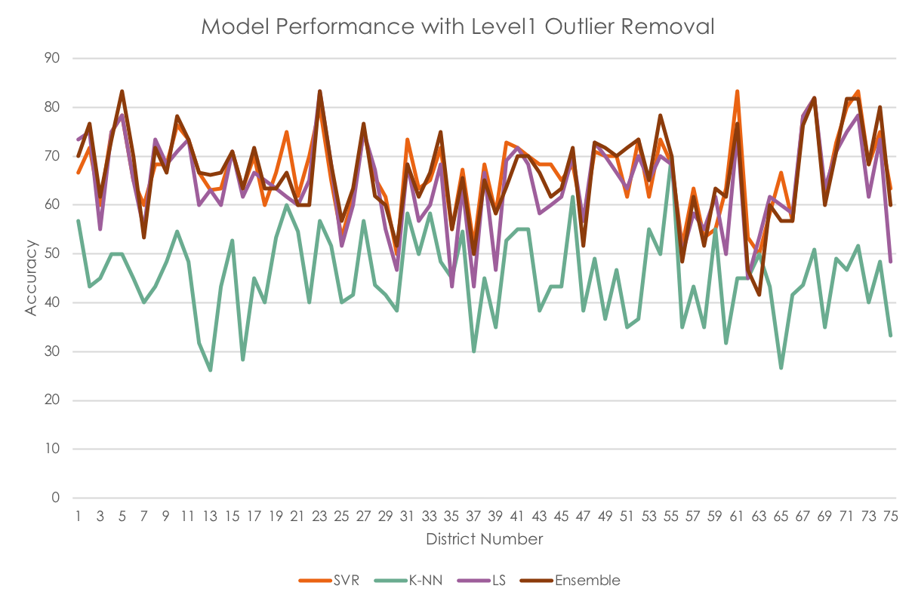
Prediction Results - Thailand
Prediction results with outlier removal
Performance for level 1 outlier removal
The model performance with level1 outlier removal

Slide 59
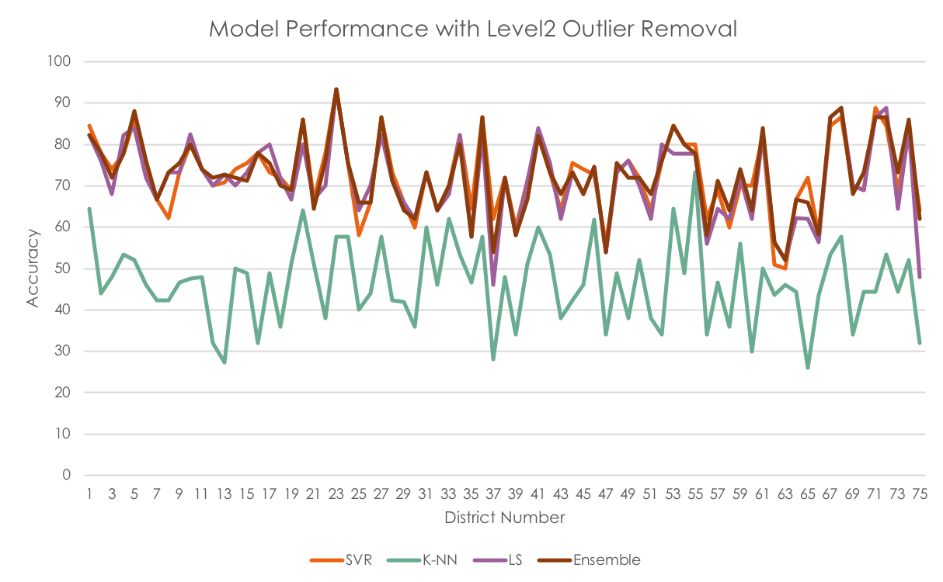
Prediction Results - Thailand
Prediction results with outlier removal
Performance for level 2 outlier removal
The model performance with level2 outlier removal

Slide 60
Resource Allocation Results – Synthetic Data
Experimental Trial Setup
Trial No | Number of facilities | Number of Resources | Facility Properties
1 | 10 | 10 | 3
2 | 50 | 5 | 3
3 | 100 | 10 | 3
4 | 500 | 10 | 3
For trials with synthetic data were performed
Data set arrangement is given in the table on the right

Slide 61
Resource Allocation Results – Synthetic Data
Facility Information (High risk facility is highlighted)
Facility | Population | Risk | Area
1 | 293,931 | 4,435 | 259
2 | 424,873 | 2,722 | 619
3 | 300,904 | 1,930 | 743
4 | 222,133 | 4,372 | 195
5 | 185,651 | 2,426 | 328
6 | 257,318 | 2,368 | 354
7 | 453,762 | 2,720 | 522
8 | 141,650 | 1,956 | 493
9 | 402,820 | 1,555 | 128
10 | 259,771 | 1,944 | 840
Trial 1
Facility information is given in the table on the right

Slide 62
Resource Allocation Results
Trial 1
Resource availability
Resource Availability
R1 | R2 | R3 | R4 | R5 | R6 | R7 | R8 | R9 | R10
1,304 | 7,441 | 7,297 | 980 | 6,276 | 9,691 | 5,735 | 6,476 | 2,754 | 146

Slide 63
Resource Allocation Results
Requested Resources from each facility
Resource Facility | R1 | R2 | R3 | R4 | R5 | R6 | R7 | R8 | R9 | R10
F1 | 43 | 369 | 362 | 49 | 208 | 481 | 190 | 214 | 91 | 5
F2 | 66 | 564 | 553 | 74 | 317 | 734 | 290 | 327 | 139 | 7
F3 | 55 | 467 | 458 | 61 | 262 | 608 | 240 | 271 | 115 | 6
F4 | 207 | 1,770 | 1,735 | 233 | 995 | 2,305 | 909 | 1,027 | 437 | 23
F5 | 102 | 875 | 858 | 115 | 492 | 1,140 | 450 | 508 | 216 | 11
F6 | 207 | 1,770 | 1,735 | 233 | 995 | 2,305 | 909 | 1,027 | 437 | 23
F7 | 129 | 1,108 | 1,087 | 146 | 623 | 1,444 | 570 | 643 | 273 | 14
F8 | 164 | 1,400 | 1,373 | 184 | 787 | 1,823 | 719 | 812 | 345 | 18
F9 | 189 | 1,614 | 1,583 | 213 | 908 | 2,102 | 829 | 936 | 398 | 21
F10 | 143 | 1,225 | 1,201 | 161 | 689 | 1,595 | 629 | 711 | 302 | 16
Trial 1
Resource demand for each facility
Lock chromosome is also given on the right
Lock Chromosome
0 | 0 | 0 | 0 | 1 | 0 | 1 | 1 | 1 | 1

Slide 64
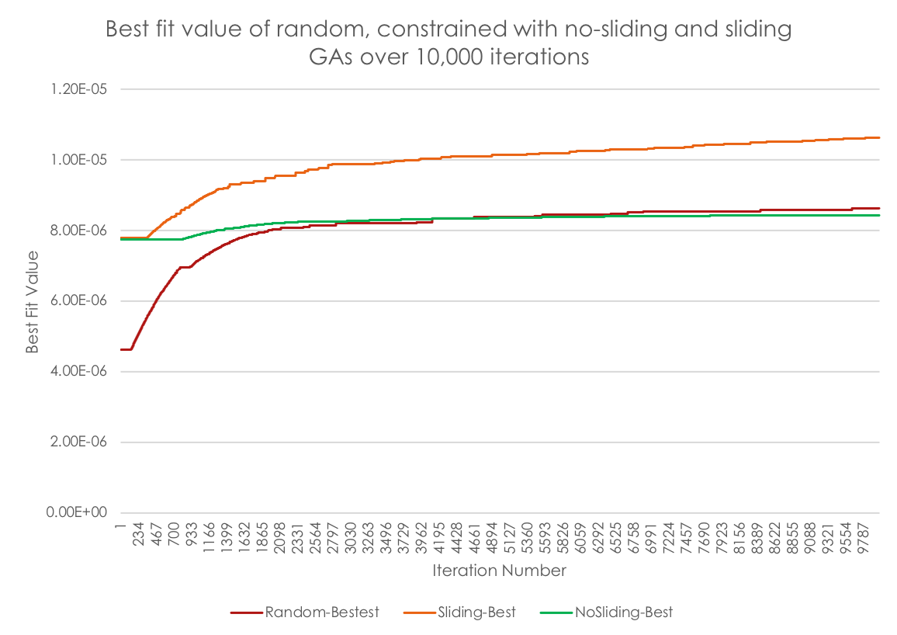
Resource Allocation Results
Trial 1
Performance of the algorithm
10 facilities
10 resources
10,000 iterations
1000 individuals in the population
churn entropy is 0.9
Mutate entropy is 0.9
The performance of proposed GA for 10 facilities requesting 10 resources

Slide 65
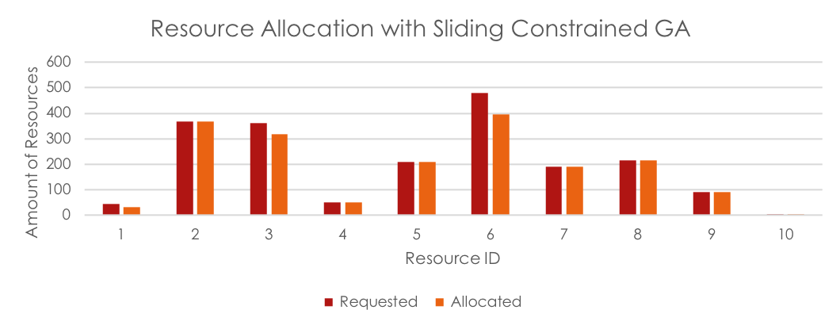
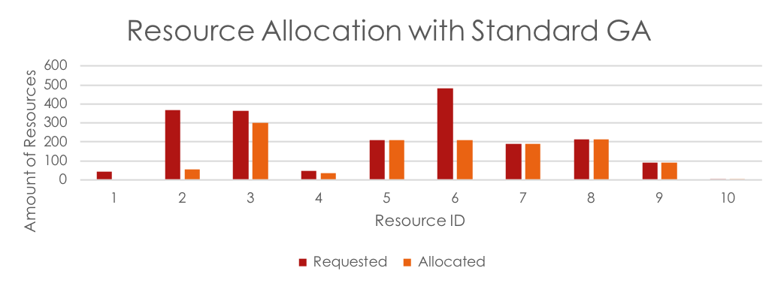
Resource Allocation Results
Trial 1
Resource allocated for high risk facility
Standard GA and proposed GA
Proposed GA gives priority to high risk facility
High risk facility and resource allocation

Slide 66
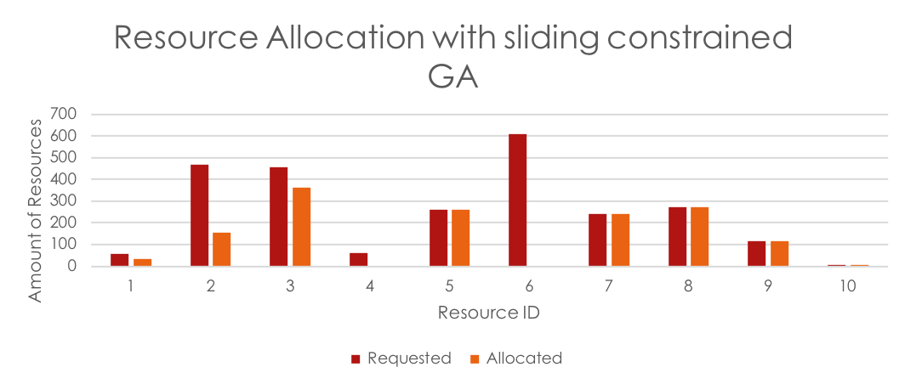
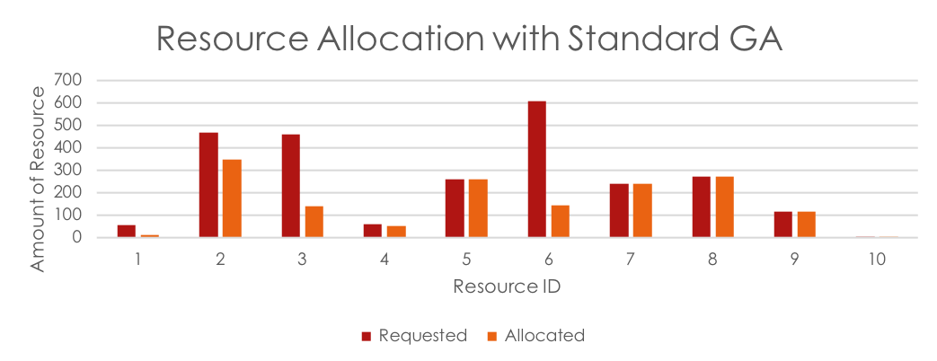
Resource Allocation Results
Trial 1
Resource allocated for low risk facility
Standard GA and proposed GA
Proposed GA gives low to low risk facility
Note: Standard GA seems to be performing better. But that treats high and low risk facilities equally
Proposed GA give priority to high risk facility over low risk facilities
Lowest risk facility and resource allocation

Slide 67
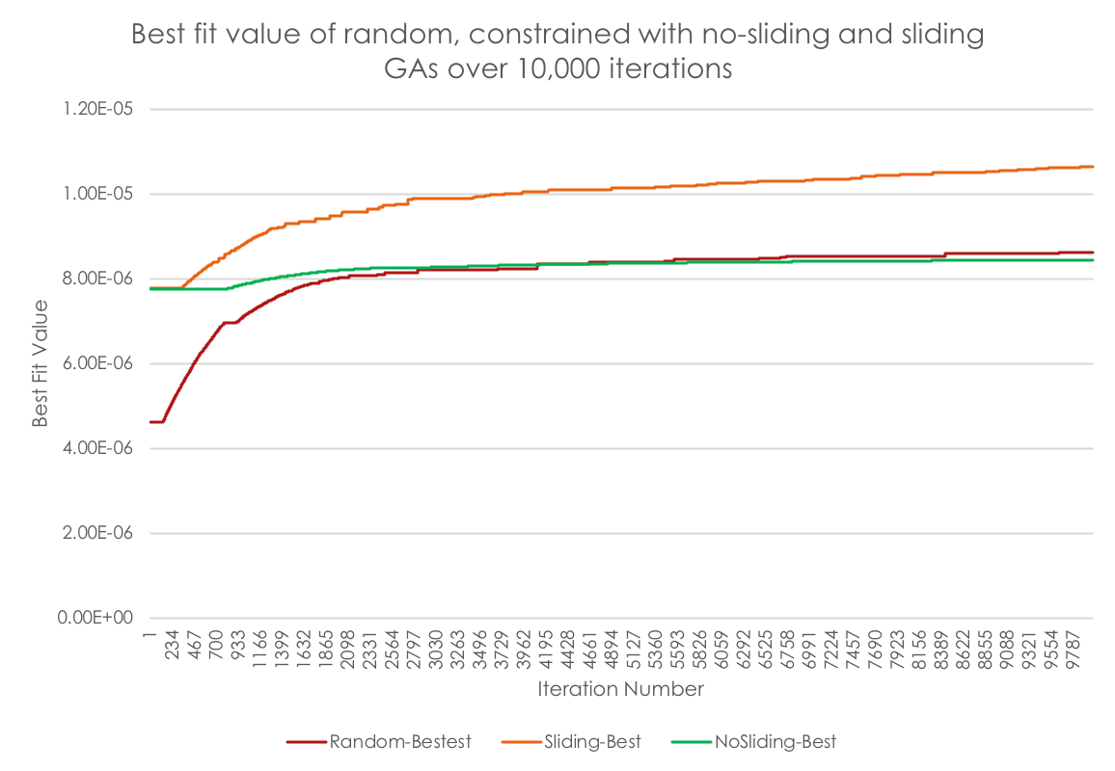
Resource Allocation Results
Trial 2
Performance of the algorithm
50 facilities
5 resources
10,000 iterations
1000 individuals in the population
churn entropy is 0.9
Mutate entropy is 0.9
Performance of the proposed GA for 50 facilities and 5 resources

Slide 68
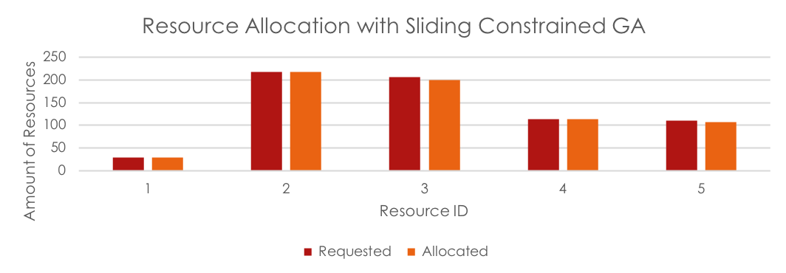
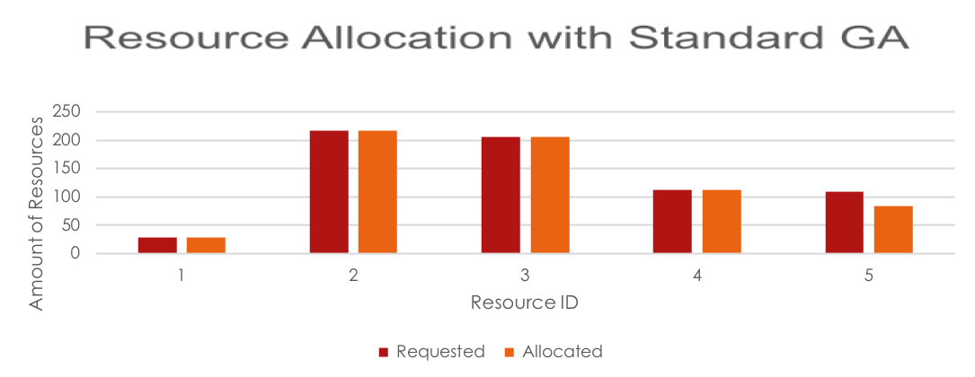
Resource Allocation Results
Trial 2
Resource allocated for high risk facility
Standard GA and proposed GA
Proposed GA gives priority to high risk facility
The resource allocation for the high-risk facility of Trail 2

Slide 69
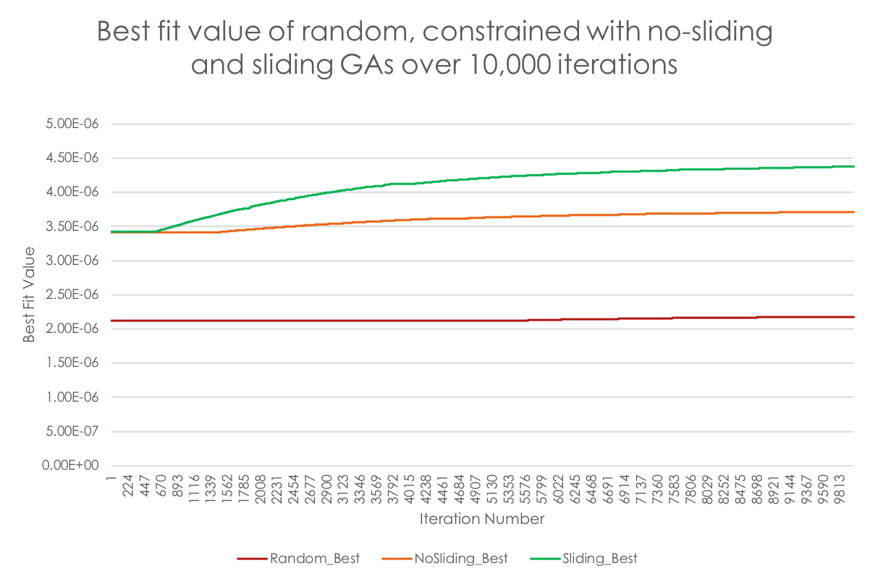
Resource Allocation Results
Trial 3
Performance of the algorithm
100 facilities
10 resources
10,000 iterations
1000 individuals in the population
churn entropy is 0.9
Mutate entropy is 0.9
The performance of the proposed GA for 100 facilities with 10 resources

Slide 70
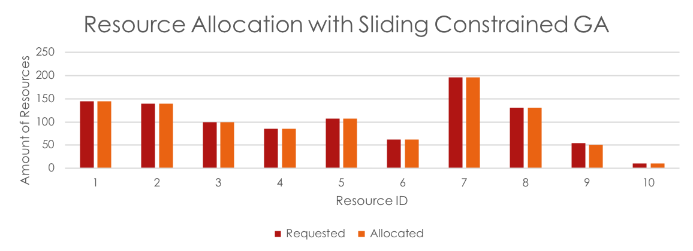
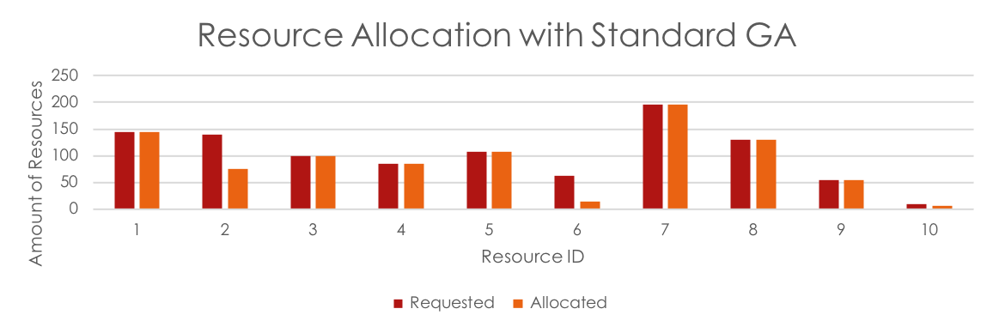
Resource Allocation Results
Trial 3
Resource allocated for high risk facility
Standard GA and proposed GA
Proposed GA gives priority to high risk facility
The resource allocation for the Trail 3

Slide 71
Conclusion
A framework for dengue mitigation was introduced
A novel method of accuracy calculation for regressions introduced
Confidence boundary concept
Novel methods of data preprocessing introduced
Year-wise data normalization
Noise removal with iterative convex hulls
Risk-based resource allocation technique proposed
An efficient and accurate GA with modifications proposed
Sliding mutation
Constrained cross over and mutation
Constrained population generation

Slide 72
Publications
Published
Journal:
1. Sumanasinghe, N., Mikler, A., Tiwari, C., & Muthukudage, J. (2016). Geo-statistical dengue risk model using GIS techniques to identify the risk prone areas by linking rainfall and population density factors in Sri Lanka. Ceylon Journal of Science,45(3), 39–46. DOI: http://doi.org/10.4038/cjs.v45i3.7399
Papers:
1. N. Sumanasinghe, A. R. Mikler, J. Muthukudage, C. Tiwari, and R. Quiroz, ‘‘Data driven prediction of dengue incidence in Thailand,’’ in Proc. Recent Adv. Inf. Commun. Technol., 2017, pp. 95–107.
2. N. S. Dinayadura, A. R. Mikler and J. Muthukudage, "An Efficient Approach of Outbreak Preparedness for Dengue," 2017 IEEE International Conference on Healthcare Informatics (ICHI), Park City, UT, 2017, pp. 327-327. doi: 10.1109/ICHI.2017.16
Preparing
Journal:
1. An Efficient Framework of Dengue Mitigation: Prediction to Resource Allocation.
Papers:
1. A Genetic Algorithmic Approach for Resource Allocation for Dengue Mitigation
2. A novel micro-ensemble architecture of dengue prediction

Slide 73
Thank you
Questions?

